Slide 1
CSE 574 Lecture 9: Dynamic Programming 2
Professor: Stephanie Gil
Email: sgil@asu.edu (Office hours M 12-1pm BYENG 386)
TAs: Sushmita Bhattacharya sbhatt55@asu.edu (Office hours M 5-6 BYENG 392)
Weiying Wang wwang239@asu.edu (Office hours Th 2:30-3:30 BYENG 392)

Slide 2
Open Loop vs. Closed Loop
Soccer!

Slide 3
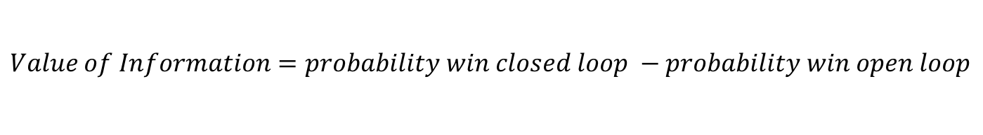
Value of Information (cont)
Value of information for our soccer match
p_{w}=0.45
p_{d}=0.9
The opposing team has a stronger offense
If you put all your guys on defense, your defense is strong
$$Value of Information=probability win closed loop −probability win open loop$$
0.53
0.425

Slide 4
Summary: Open loop vs. Closed Loop
Is information about the current state always valuable when deciding on a policy?
If information is so valuable then the more information the better right? Should I carry around my entire history of states and actions?

Slide 5
Principle of Optimality
The principle behind Dynamic Programming
Section 1.3 Dynamic Programming and Optimal Control Vol 1 Text

Slide 6
Intuitive Explanation
Solve from the last stage iteratively until you have a strategy for the whole route!

Slide 7

Link to Something We’ve Already Seen
We saw this with Bellman’s Equation (recall step 2 of policy iteration)
If the truncated policy was not optimal then would policy iteration improve the policy?
Does PI converge to the optimal policy?
$$π_{i+1}\left(s\right)=\arg{\max_{a}{\sum_{s′}{p\left(s,a,s^{′}\right)[R\left(s,a,s^{′}\right)+γv_{π_{i}}\left(s^{′}\right)]}}}$$

Slide 8




The Dynamic Programming Algorithm
$$J_{}^{∗}\left(x_{0}\right)=\min_{π∈Π} E\left\{g_{N}\left(x_{N}\right)+\sum_{k=0}^{N−1}{g_{k}(x_{k},μ_{k}\left(x_{k}\right),w_{k})}\right\}$$
Recall:
Dynamic Programming Algorithm
$$J_{N}\left(x_{N}\right)=g_{N}\left(x_{N}\right)$$
$$J_{k}\left(x_{k}\right)=\min_{u_{k}∈U_{k}(x_{k})}{E_{w_{k}}\left\{g_{k}\left(x_{k},u_{k},w_{k}\right)+J_{k+1}(f_{k}(x_{k},u_{k},w_{k})\right\}, }$$
$$k=0,1,…,N−1$$

Slide 9
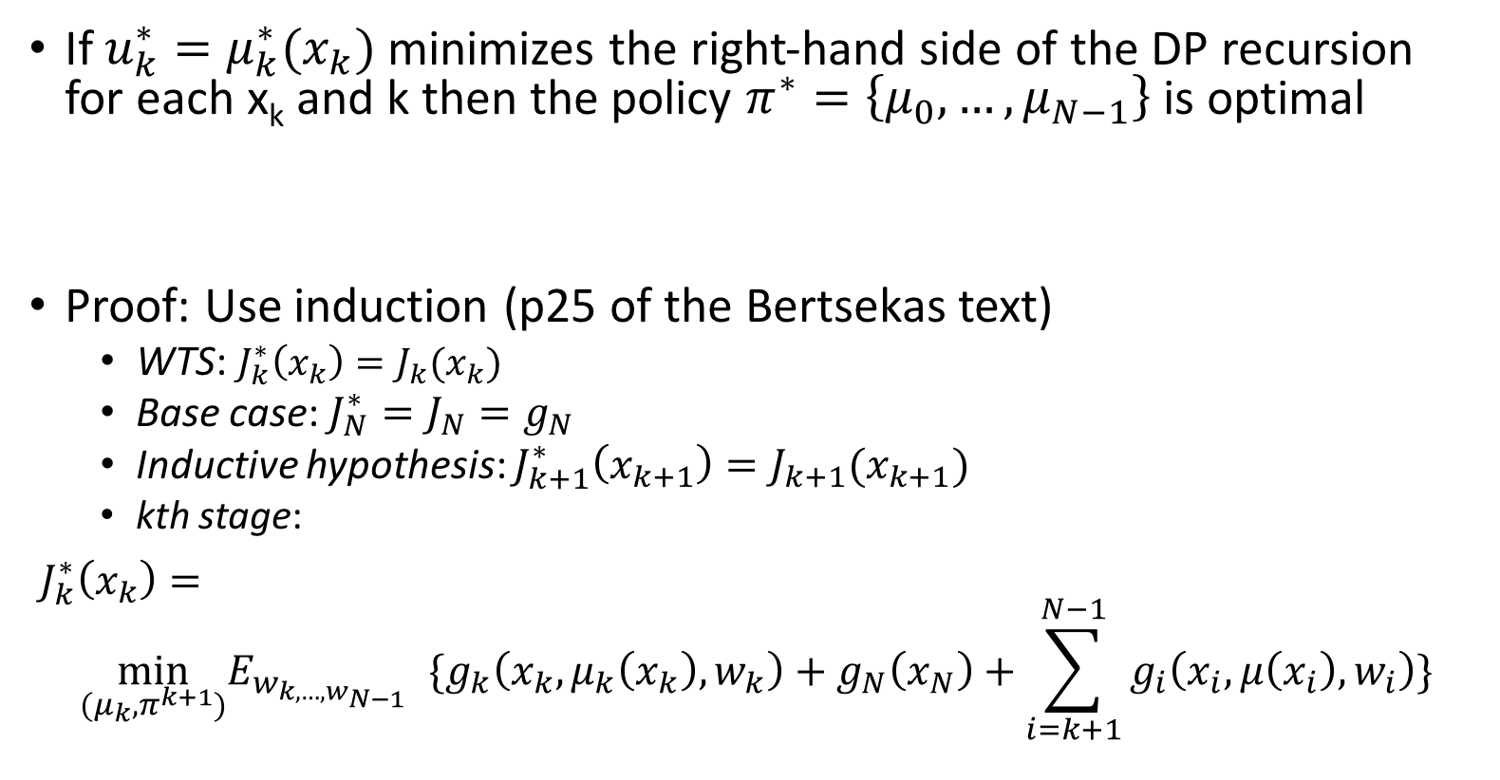

Optimality and the DP Algorithm
If $u_{k}^{∗}=μ_{k}^{∗}(x_{k})$ minimizes the right-hand side of the DP recursion for each x_{k} and k then the policy $π^{∗}=\left\{μ_{0},…,μ_{N−1}\right\}$ is optimal
Proof: Use induction (p25 of the Bertsekas text)
WTS: $J_{k}^{∗}\left(x_{k}\right)=J_{k}(x_{k})$
Base case: $J_{N}^{∗}=J_{N}=g_{N}$
Inductive hypothesis: $J_{k+1}^{∗}\left(x_{k+1}\right)=J_{k+1}(x_{k+1})$
kth stage:
$J_{k}^{∗}\left(x_{k}\right)=$
$$\min_{(μ_{k},π^{k+1})}E_{w_{k,…,w_{N−1}}}{\{g_{k}\left(x_{k},μ_{k}\left(x_{k}\right),w_{k}\right)+g_{N}\left(x_{N}\right)+\sum_{i=k+1}^{N−1}{g_{i}\left(x_{i}, μ\left(x_{i}\right), w_{i}\right)}\}}$$
$$J_{k}\left(x_{k}\right)=\min_{u_{k}∈U_{k}(x_{k})}{E_{w_{k}}\left\{g_{k}\left(x_{k},u_{k},w_{k}\right)+J_{k+1}(f_{k}(x_{k},u_{k},w_{k})\right\}}$$

Slide 10
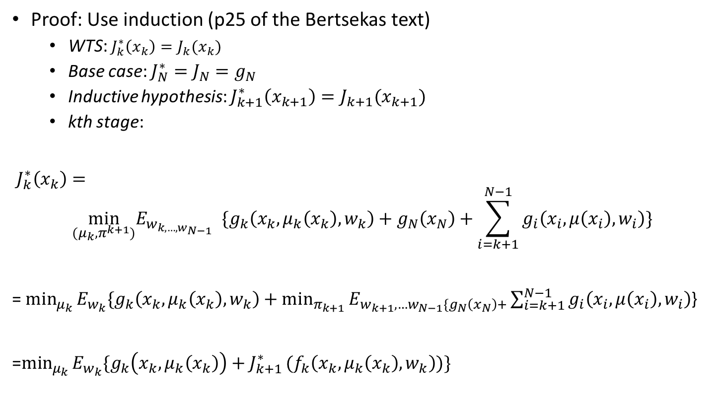
Optimality and the DP Algorithm (cont)
Proof: Use induction (p25 of the Bertsekas text)
WTS: $J_{k}^{∗}\left(x_{k}\right)=J_{k}(x_{k})$
Base case: $J_{N}^{∗}=J_{N}=g_{N}$
Inductive hypothesis: $J_{k+1}^{∗}\left(x_{k+1}\right)=J_{k+1}(x_{k+1})$
kth stage:
$J_{k}^{∗}\left(x_{k}\right)=$
$$\min_{(μ_{k},π^{k+1})}E_{w_{k,…,w_{N−1}}}{\{g_{k}\left(x_{k},μ_{k}\left(x_{k}\right),w_{k}\right)+g_{N}\left(x_{N}\right)+\sum_{i=k+1}^{N−1}{g_{i}\left(x_{i}, μ\left(x_{i}\right), w_{i}\right)}\}}$$
= $\min_{μ_{k}}{E_{w_{k}}\{g_{k}\left(x_{k},μ_{k}\left(x_{k}\right),w_{k}\right)+\min_{π_{k+1}}{E_{w_{k+1},…w_{N−1}\{g_{N}\left(x_{N}\right)+}}}\sum_{i=k+1}^{N−1}{g_{i}\left(x_{i}, μ\left(x_{i}\right), w_{i}\right)}$}
=$\min_{μ_{k}}{E_{w_{k}}\{g_{k}\left(x_{k},μ_{k}\left(x_{k}\right)\right)+J_{k+1}^{∗}}(f_{k}\left(x_{k}, μ_{k}\left(x_{k}\right),w_{k}\right))\}$
Principle of optimality
Next step: use inductive hypothesis

Slide 11
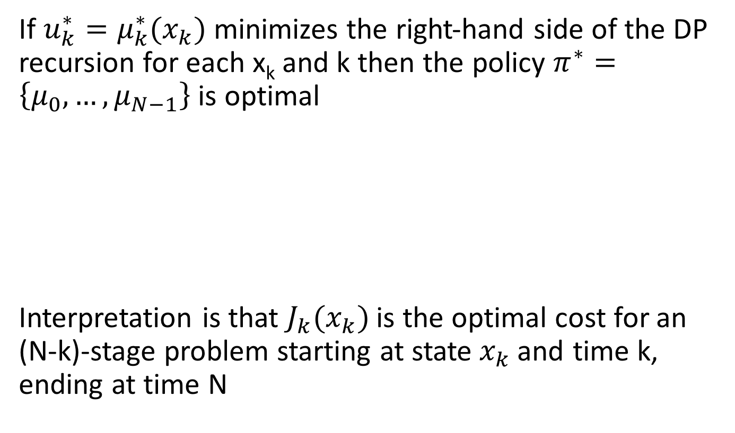

“Cost-to-Go”
If $u_{k}^{∗}=μ_{k}^{∗}(x_{k})$ minimizes the right-hand side of the DP recursion for each x_{k} and k then the policy $π^{∗}=\left\{μ_{0},…,μ_{N−1}\right\}$ is optimal
Interpretation is that $J_{k}(x_{k})$is the optimal cost for an (N-k)-stage problem starting at state$x_{k}$and time k, ending at time N
$$J_{k}\left(x_{k}\right)=\min_{u_{k}∈U_{k}(x_{k})}{E_{w_{k}}\left\{g_{k}\left(x_{k},u_{k},w_{k}\right)+J_{k+1}(f_{k}(x_{k},u_{k},w_{k})\right\}}$$
“Cost-to-go” function

Slide 12
Inventory Control Problem Revisited
Apply dynamic programming approach to inventory control problem
Fig 1.1.2 in the Bertsekas Optimal Control and Dynamic Programming Vol 1 text

Slide 13
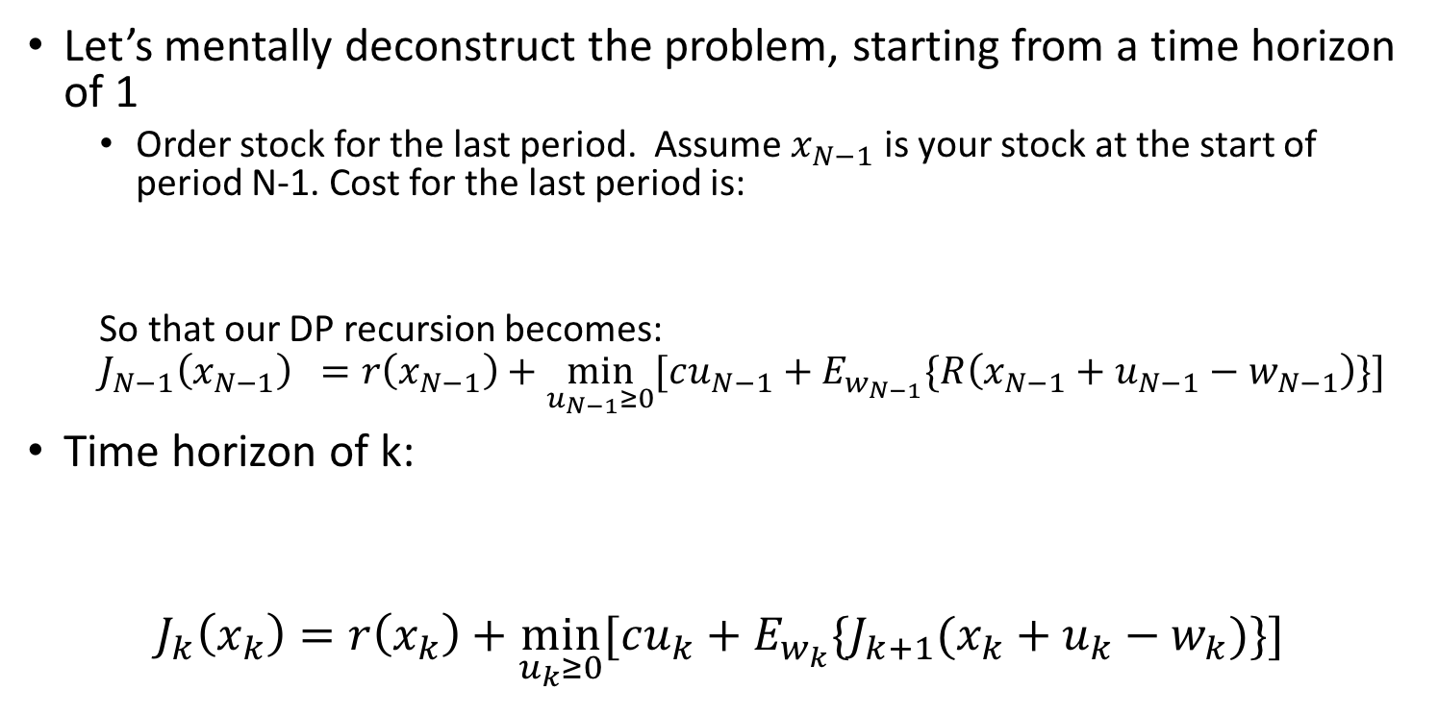

Inventory Control Problem Revisited
0=N-N
N-2
N-1
N
Let’s mentally deconstruct the problem, starting from a time horizon of 1
Order stock for the last period. Assume $x_{N−1}$ is your stock at the start of period N-1. Cost for the last period is:
So that our DP recursion becomes:
$$J_{N−1}\left(x_{N−1}\right) =r\left(x_{N−1}\right)+\min_{u_{N−1}≥0}{[cu_{N−1}+E_{w_{N−1}}\{R\left(x_{N−1}+u_{N−1}−w_{N−1}\right)\}]}$$
Time horizon of k:
$$J_{k}\left(x_{k}\right)=r\left(x_{k}\right)+\min_{u_{k}≥0}{[cu_{k}+E_{w_{k}}\{J_{k+1}(x_{k}+u_{k}−w_{k})\}]}$$
$$cu_{N−1}+E_{w_{N−1}}\{R\left(x_{N−1}+u_{N−1}−w_{N−1}\right)\}$$
Expected cost of periods k+1,..,N-1, given that an optimal policy will be used for those periods
Expected cost of period k

Slide 14
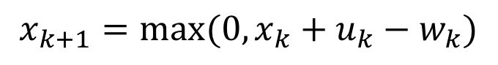


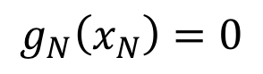
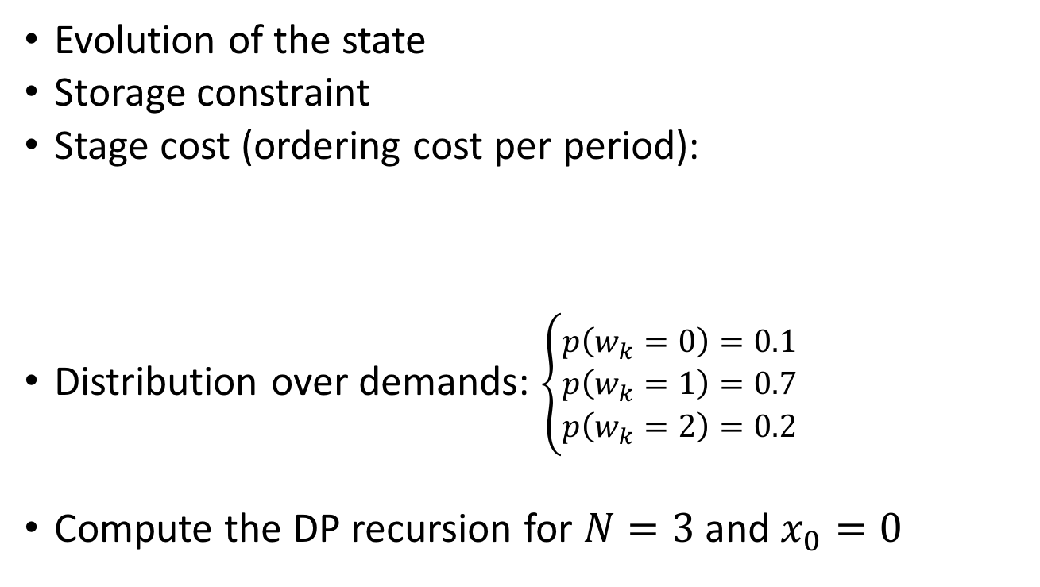
Inventory Example: Working it Out
$$x_{k+1}=\max{(0,x_{k}+u_{k}−w_{k})}$$
Evolution of the state
Storage constraint
Stage cost (ordering cost per period):
Distribution over demands: $\left\{\begin{aligned}p\left(w_{k}=0\right)=0.1 \\ p\left(w_{k}=1\right)=0.7 \\ p\left(w_{k}=2\right)=0.2\end{aligned}\right.$
Compute the DP recursion for $N=3$ and $x_{0}=0$
$$x_{k}+u_{k}≤2$$
$$g_{N}\left(x_{N}\right)=0$$
$$g_{k}\left(x_{k},u_{k},w_{k}\right)=u_{k}+{\left(x_{k}+u_{k}−w_{k}\right)}^{2}$$

Slide 15




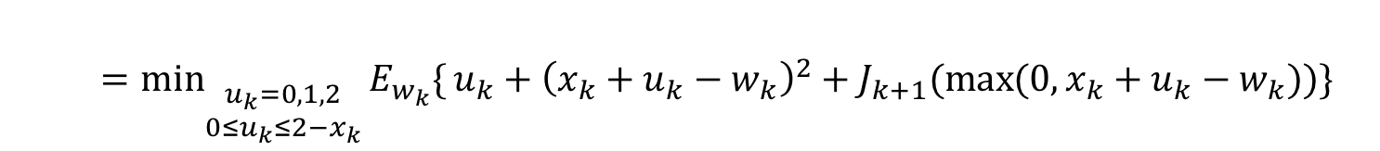

Inventory Example: Working it Out
$$J_{3}\left(x_{3}\right)=0$$
DP Equation for this problem
$$u_{k}=0,1,2$$
$$J_{k}\left(x_{k}\right)=\min_{u_{k}∈U_{k}\left(x_{k}\right)}{E_{w_{k}}\{}g_{k}\left(x_{k},u_{k},w_{k}\right)+J_{k+1}(f_{k}\left(x_{k},u_{k},w_{k}\right)\}$$
$$x_{k}=0,1,2$$
$$k=0,1,2$$
$=\min_{\begin{aligned}\begin{aligned} \\ u_{k}=0,1,2\end{aligned} \\ 0≤u_{k}≤2−x_{k}\end{aligned}}{E_{w_{k}}\{}{u_{k}+\left(x_{k}+u_{k}−w_{k}\right)}^{2}+J_{k+1}(\max{(0,x_{k}+u_{k}−w_{k})})\}$
Three possible states:
Stock = 0
Stock = 1
Stock = 2
Three possible actions:
Stock purchased =0
Stock purchased = 1
Stock purchased =2
All of these actions are not
available for every state! Why?
Figure 1.3.2 Bertsekas text

Slide 16
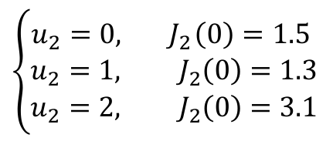


Inventory Example: Working it Out
N-1
N
Start at the last period
$$J_{2}\left(0\right)=\min_{u_{k}=0,1,2}{E_{w_{2}}\{{u_{2}+\left(u_{2}+x_{2}−w_{2}\right)}^{2}+J_{3}\left(x_{3}\right)\}}$$
= $\min_{u_{k}=0,1,2}{E_{w_{2}}\{{u_{2}+\left(u_{2}−w_{2}\right)}^{2}\}}$
$=\min_{u_{2}=0,1,2}{\begin{aligned}[0.1\left(u_{2}+u_{2}^{2}\right)+0.7\left(u_{2}+{\left(u_{2}−1\right)}^{2}\right)+ \\ 0.2\left(u_{2}+{\left(u_{2}−2\right)}^{2}\right)]\end{aligned}}$
Expectation over demand values
$$μ_{2}^{∗}\left(0\right)=1$$
$$\left\{\begin{aligned}u_{2}=0, { J}_{2}\left(0\right)=1.5 \\ u_{2}=1, J_{2}\left(0\right)=1.3 \\ u_{2}=2, J_{2}\left(0\right)=3.1\end{aligned}\right.$$
Figure 1.3.2 Bertsekas text

Slide 17
Inventory Example: Working it Out
0=N-N
N-2
N-1
N
Continue propagating backwards (apply DP eqn recursively)
Figure 1.3.2 Bertsekas text

Slide 18
Open Loop vs. Closed Loop
Soccer!

Slide 19
Example DP Applied to Soccer
World Cup!
Rules of the game:
Timid play
Draw with probability p_{d}
Lose with probability (1-p_{d})
Bold play
Win with probability p_{w}
Lose with probability (1-p_{w})
If there is a draw after the second half, sudden death round
Optimal closed-loop strategy:
Play timid if and only if your team is ahead in the score
Bold play versus timid play strategy

Slide 20
Problem Setting
You are team Mexico
You are playing Germany
What if?....
Before the world cup starts: You know you’re playing Germany this world cup
During the world cup: Find the optimal strategy to win against Germany

Slide 21

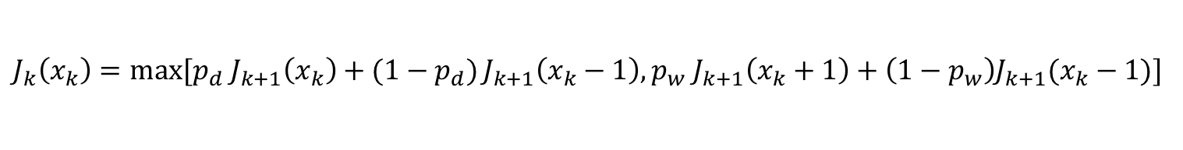

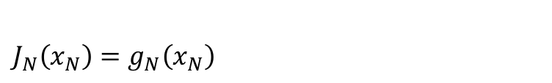
Problem Formulation
State:
Decision space:
DP recursion:
Current net score {1,0,-1}
Decisions are play style {timid, bold}
$$\left\{\begin{aligned}1, if x_{N}>0 \\ p_{w}, if x_{N}=0 \\ 0, if x_{N}<0\end{aligned}\right.$$
$$J_{N}\left(x_{N}\right)=g_{N}\left(x_{N}\right)$$
What is the terminal cost/gain for our example?
$$J_{k}\left(x_{k}\right)=\min_{u_{k}∈U_{k}(x_{k})}{E_{w_{k}}\left\{g_{k}\left(x_{k},u_{k},w_{k}\right)+J_{k+1}(f_{k}(x_{k},u_{k},w_{k})\right\}, }$$
$$k=0,1,…,N−1$$
All the possible outcomes and their probabilities…
$J_{k}\left(x_{k}\right)=\max{[p_{d}{ J}_{k+1}\left(x_{k}\right)+(1−p_{d})}J_{k+1}\left(x_{k}−1\right), p_{w} J_{k+1}\left(x_{k}+1\right)+\left(1−p_{w}\right)J_{k+1}(x_{k}−1)]$
Notice that this time we use max
Timid play
Bold play

Slide 22

Optimal Policy: Last Stage
The DP recursion tells us that it is optimal to play bold when:
Assume that $p_{d}>p_{w}$. The equations for the last stage N-1 are:
Winning by a large enough margin or losing too badly to recover

Slide 23

Optimal Policy: Second to Last Stage
Stage N-2:
Can continue all the way to stage 0….
Analysis: region of pairs $(p_{w},p_{d})$where the player has a better than 50-50 chance to win a 2-game match:

Slide 24
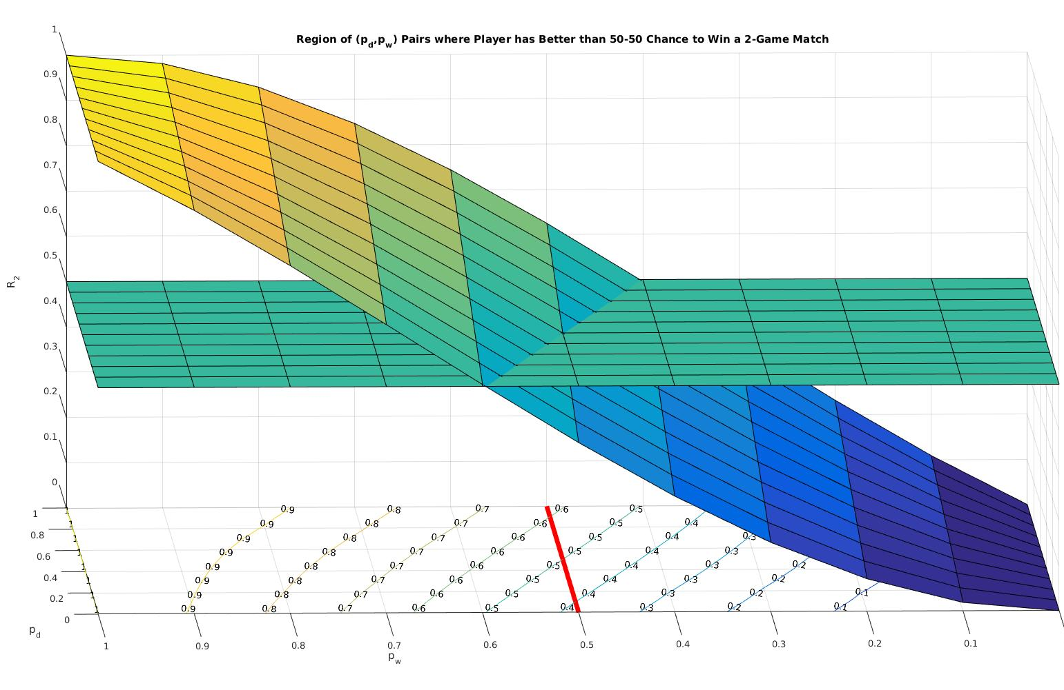
Chances of Winning with Optimal Closed Loop Policy

Slide 25
Next Time…
HW 3 is posted (due Sept 28th at 5pm)
Minimax control and augmented formulations
Readings will be posted on Blackboard → special access made possible by Prof. Dimitri Bertsekas to his Dynamic Programming and Optimal Control text!

